Slide 1
Music Sphere
The Viables –
Chintan Pathak [ pathak.c@husky.neu.edu ]
Hardik Shah [ shah.h@husky.neu.edu ]
Mukul Sharma [ sharma.mu@husky.neu.edu ]
Sagar Gopani [ gopani.s@husky.neu.edu ]

Slide 2
Project Objectives
Purpose is to make a music tool that helps the user to listen & browse through all kind of music available online.
The website provides the following features:
User can create his own profile
User can access his recently played songs and favorites tracks
User can listen to songs online
User can browse through the songs using the search option
User can download songs

Slide 3
Requirement Description
The primary requirement is to develop an OData endpoint for a Web based Music tool.
Firstly, an OData endpoint is to be established for querying the MYSQL database, to generate user readable responses.
The inputs given by the user are converted into OData queries(URL).
The responses are obtained in XML/JSON format. They should be parsed and rendered into HTML pages.

Slide 4
Technologies
We have used the following tools and technologies:
Front End : PHP, HTML
Database : MySQL
Web Server : Apache
Data Model : OData

Slide 5
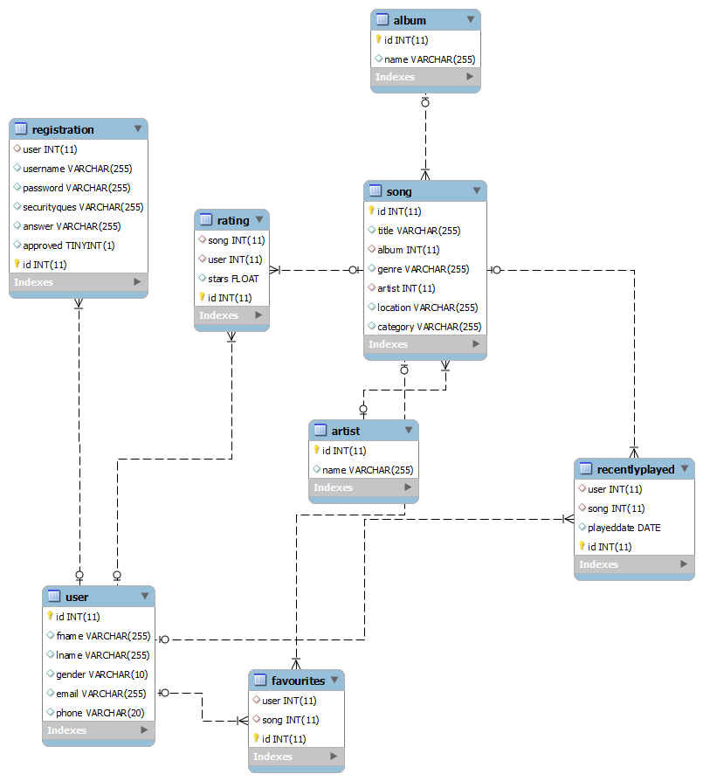
Database Design

Slide 6
Demo
Ride to demo starts here. !

Slide 7
Thank You

